Slide 1
Employee Data Analysis using Excel
STUDENT NAME:
REGISTER NO:
DEPARTMENT:
COLLEGE
Archana.B
312216141&asunm1621312216141
B.COM Accounting and Finance
Shri Shankarlal Sundarbai Shasun jain College for women

Slide 2
PROJECT TITLE
Employee Performance Analysis using Excel

Slide 3


AGENDA
Problem Statement
Project Overview
End Users
Our Solution and Proposition
Dataset Description
Modelling Approach
Results and Discussion
Conclusion
3/21/2024 Annual Review

Slide 4

PROBLEM STATEMENT
Measuring key performance indicators (KPIs) to assess the system's speed, responsiveness, and resource utilization

Slide 5

PROJECT OVERVIEW
.
Clearly defining the system or application to be analyzed, including its components, dependencies, and expected behavior.

Slide 6
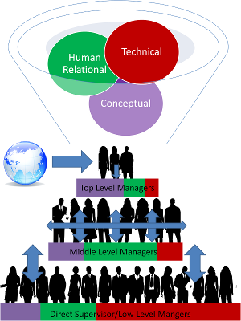

WHO ARE THE END USERS?
The Users of this analysis are
1.Board of Directors
2.Mangers
3.Employers
4.Employee and more

Slide 7

OUR SOLUTION AND ITS VALUE PROPOSITION
Using too many performance analysis tools, leading to data overload and complexity. Unnecessary Granularity: Collecting excessive amounts of data at a very fine-grained level, which can be difficult to analyze and interpret.

Slide 8
Dataset Description
dataset for performance analysis typically contains information about the behavior of a system or application over time. It can include various metrics, such as:
Response time: The time it takes for a system to respond to a request.
Throughput: The number of requests a system can handle per unit of time.
Resource utilization: The consumption of resources like CPU, memory, disk I/O, and network bandwidth.

Slide 9

THE "WOW" IN OUR SOLUTION
Provide actionable insights: Going beyond simple data collection and visualization, the solution should offer clear, actionable recommendations for improving performance.
3/21/2024 Annual Review
9

Slide 10
MODELLING
Queueing Models: These models are particularly useful
For systems that involve waiting lines, such as call centers, networks, and servers. They represent the system as a series of queues and servers, and analyze the flow of entities (e.g., customers, jobs) through the system.
Petri Nets: A graphical modeling technique that uses places (representing resources) and transitions (representing activities) to model the flow of entities through a system. Petri nets can be used to represent concurrency, synchronization, and conflict in complex system.
10

Slide 11
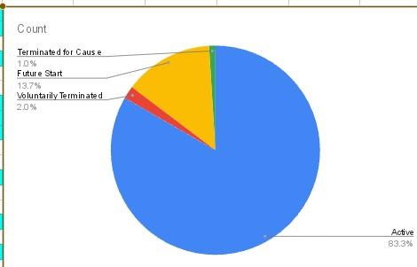
RESULTS
This chart deals with employee performance in each department .
11

Slide 12
conclusion
And hence it is concluded that the MSC ,with its production in Medium performance level is higher when compared with other departments.

